Slide 1
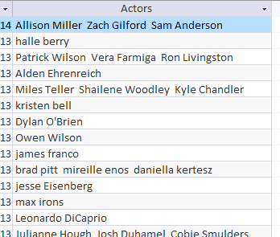
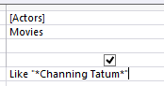
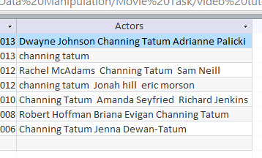
Wild Card – Sometimes a field may contain more than one word. To find something specific you need to write a wildcard search. Like “*Channing Tatum *”
Between | Between 01/01/2010 And 02/02/2012 Between 100 And 150
Or | North Sea Or Irish Sea
Not | Not “Horror”
<90 | Less than <90
>90 | More than >90
>=90 | More than and equal to >=90
37*____ | Fields starts with 37
____*37 | Fields Ends with 37
Only field containing Channing Tatum are shown

Slide 2
Create a Report for the following scenarios. Remember before you create the report you must create the Query. Identify whether each task is completed in a query or report or could be done in both.
Report 1: (Title: Forward Players) Show the following Fields only: Name, Position, Club and Goals Show only the records which include: Position – Forward Goals - > 20 Fits on a single page wide with a page orientation of Portrait --- Report
Report 2: (Title: Juventus and Man City Players) Show the following Fields only: Name, Position, Nationality, Club and Values Show only the records which include: Clubs – Juventus or Man City Nationality - Italy Fits on a single page wide with a page orientation of Portrait --- Report
Report 3: (Title: Man Utd Players) Show the following Fields only: Name, Position, Value, Goals and Club Show only the records which include: Goals – <10 (Less than 10 goals) Position – Defender Club – Man Utd Fits on a single page wide with a page orientation of Portrait --- Report
Total Records:
Total Records:
Total Records:

Slide 3
Create a Report for the following scenarios. Remember before you create the report you must create the Query. Identify whether each task is completed in a query or report or could be done in both.
Report 4: (Title: Bayern Munich) Show the following Fields only: Name, Position, Nationality, Club and Goals Show only the records which include: Club – Bayern Munich Nationality – Germany or Croatia Fits on a single page wide with a page orientation of Portrait --- Report
Report 5: (Title: Goals) Show the following Fields only: Name, Goals, Position, Club and Nationality Show only the records which include: Goals – Between 10 and 30 goals Nationality – Italy or Spain Fits on a single page wide with a page orientation of Portrait --- Report
Report 6: (Title: Players born in the 1980s) Show the following Fields only: Name, DOB, Position, Value, Goals and Club Show only the records which include: DOB – Players born in 1980 (01/01/1980 – 31/12/1989) Goals – Scored Between 15 and 25 goals Fits on a single page wide with a page orientation of Portrait --- Report
Total Records:
Total Records:
Total Records:

Slide 4
Create a Report for the following scenarios. Remember before you create the report you must create the Query. Identify whether each task is completed in a query or report or could be done in both.
Report 7: (Title: Arsenal and Barcelona Players) Show the following Fields only: Name, Position, Club, Nationality and Goals Show only the records which include: Goals – Less than 10 goals Position – Not Goal Keeper Club – Arsenal or Barcelona Nationality – Not Brazil Fits on a single page wide with a page orientation of Landscape --- Report Include a formula in the Report Footer to Count the number of Players --- Report
Report 8: (Title: Player born in the 1990s) Show the following Fields only: Name, DOB, Position, Goals and Nationality Show only the records which include: DOB – Players born in 1990 (01/01/1990 – 31/12/1999) Nationality – Not Italy Players Goals – 10 or more goals Goals in Descending Order Fits on a single page wide with a page orientation of Landscape --- Report Include a formula in the Report Footer to Count the number of Players --- Report
Total Records:
Total Records:

